Slide 1
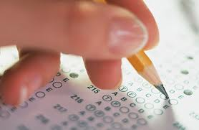
PSAT
MATHEMATICS

Slide 2
WHTY TAKE THE PSAT?
Provides excellent practice for the SAT
Connects students to personalized college and career planning tools
Provides indicators of AP Success

Slide 3
THE BASICS - MATH
Two 25-minute sections
38 questions
28 Multiple Choice Questions
10 Student-Produced Response Questions
No point deductions for guessing - answer all questions!

Slide 4
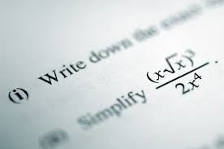
CONCEPTS COVERED
Number and operations
Algebra and functions
Geometry and measurement
Data analysis, statistics, and probability
Does NOT cover content covered in third-year math classes (SAT does)

Slide 5
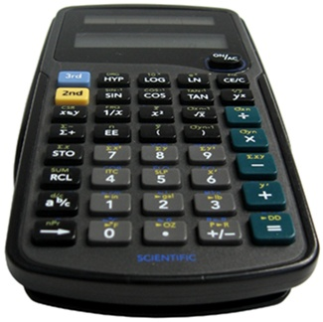
CALCULATORS
Must bring your own, cannot share
Four-function, scientific, and graphing calculators are allowed
Calculators with a QWERTY keyboard are NOT allowed
NOT allowed to use a calculator on a laptop or other hand-held device

Slide 6
STUDENT-PRODUCED REPONSES
Write answers in boxes above grid to avoid errors in gridding
Some questions may have more than one right answer – grid only one
No point deductions for wrong answers – answer every question

Slide 7
STUDENT-PRODUCED RESPONSES
Mark no more than one circle in any column, only answers entered in circles will be graded
It does not matter in which column students begin entering answers, as long as the correct answer is gridded
The grid only holds four places and can accommodate only positive numbers and zero

Slide 8
STUDENT-PRODUCED RESPONSES: REPEATING DECIMALS
For repeating decimals, use all columns

Slide 9
STUDENT-PRODUCED REPSONSES: FRACTIONS
Unless specified, an answer can be entered on the grid as a decimal or a fraction
You DO NOT need to reduce fractions to the lowest form (i.e., 3/24)

Slide 10
STUDENT-PRODUCED RESPONSES: MIXED NUMBERS
Convert mixed numbers to improper fractions before gridding answer

Slide 11
STUDENT-PRODUCED RESPONSES: PERCENTAGES
Convert percentages to decimals or fractions
Do NOT write the zero before the decimal point

Slide 12
MULTIPLE-CHOICE
Look at the answer choices before beginning the problem, if you are not sure what is being asked
Read each question carefully, even if it looks like a question you do not think you can answer – TRY IT!
If your answer is not among the choices, try writing it in a different mathematical format

Slide 13
PRACTICE TESTS & MORE INFO
Try some problems on your own!
https://www.collegeboard.org/psat-nmsqt/preparation

